Slide 1
Module 1: SQL Server 2005 Overview

Slide 2

Overview
SQL Server 2005 Components and Architecture
SQL Server 2005 Developer Tools
SQL Server 2005 Security Implementation

Slide 3
Lesson: SQL Server 2005 Components and Architecture
SQL Server 2005 Components
New Database Administrator Features
New Database Developer Features
The AdventureWorks Sample Database

Slide 4







SQL Server 2005 Components
Data Transformation Services
Analysis Services
Notification Services
SQL Server 2005
Full-Text Search
Relational Database Engine
Reporting Services
.NET CLR
Replication
Service Broker
Native HTTP Support

Slide 5
New Database Administrator Features
Improved product installation
Centralized administrative tools
New security architecture
High-availability support
System enhancements

Slide 6
New Database Developer Features
Transact-SQL enhancements
Native XML support
Message-based services
Native HTTP support
Notification Services
Common Language Runtime integration
Reporting Services
SQL Management Objects

Slide 7

The Adventure Works Sample Database
Fictitious bicycle manufacturing company
AdventureWorksDW OLAP database
  Business intelligence data
AdventureWorks OLTP database

Slide 8
Lesson: SQL Server Developer Tools
Developer Tools in SQL Server 2005
What Is SQL Server Management Studio?
Demonstration: Executing a Query
Demonstration: Using Object Explorer
Demonstration: Creating a SQL Server Solution

Slide 9
Developer Tools in SQL Server 2005
SQL Server Management Studio
Business Intelligence Development Studio
sqlcmd
Visual Studio designers

Slide 10
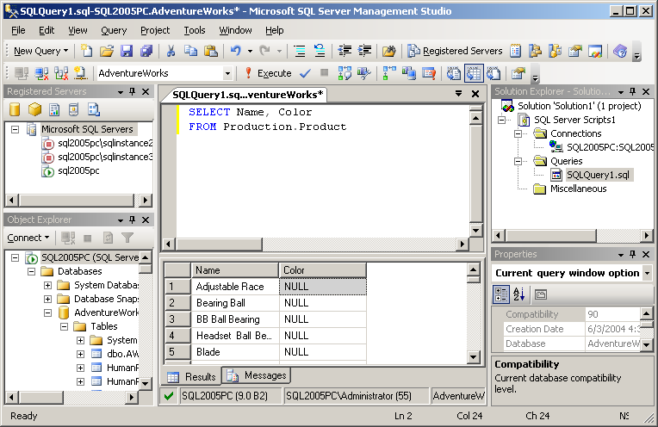
What Is SQL Server Management Studio?
Integrated environment for database development

Slide 11

Demonstration: Executing a Query
In this demonstration, you will see how to execute a query in SQL Server Management Studio

Slide 12
Demonstration: Using Object Explorer
In this demonstration, you will see how to use Object Explorer to manage SQL Server objects

Slide 13
Demonstration: Creating a SQL Server Solution
In this demonstration, you will see how to create a SQL Server solution

Slide 14
Lesson: SQL Server 2005 Security Implementation
Multimedia: SQL Server 2005 Security Architecture
About Using Schemas to Manage Security

Slide 15

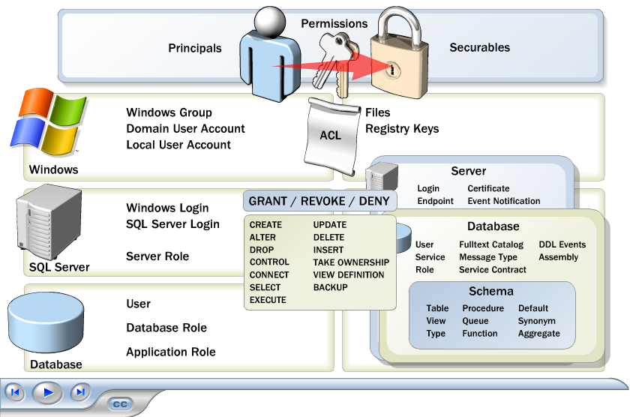

Multimedia: SQL Server 2005 Security Architecture

Slide 16
About Using Schemas to Manage Security
Managing schemas
Assigning a default schema
Managing permissions with schemas
CREATE SCHEMA salesdata
ALTER USER Peter
WITH DEFAULT_SCHEMA = salesdata
GRANT SELECT ON SCHEMA::salesdata TO salesrole

Slide 17

Lab 1: Exploring SQL Server 2005
Exercise 1: Using SQL Server Management Studio
Exercise 2: Using Schemas

